Slide 1

COOP Project Meeting
Data Review, Analysis and Publications
2/13/2025

Slide 2
Data Summary
Coop Yield Trials
2022 – 94 Hybrids
5 locations in Iowa (KYS02, CRL06, BRKAb, CRW14 and MRSE)
2 Reps in 4 Locs and 3 Reps in 1
USDA 3Way Crosses, UIUC Hybrids and Checks
2023 and 2024 – 240 Hybrids
2 Locations in Iowa (MRSC and BRKB)
1 Location in Urbana
Testcrosses of BS39-derived DH lines
GEM Hybrids
UIUC Hybrids and 3Ways
Kitale population Testcrosses
6 Commercial organic checks (BR, PH, VK)
Agronomic traits and grain quality
Spectral data (950 to 1650 Wavelength)
Illinois Yield Trials (2021 – 2024)
185 hybrids
ExPVP recombinant inbred (UIUC)
Organic hybrids (Mandaamin - WI)
Conventional hybrids (Montgomery)
Kitale population Testcrosses
Hybrids from ISU breeding programs
Three-way hybrids
High-impact hybrids from (G2F)
Ten commercial organic checks

Slide 3
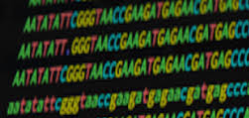
Genotypic Data (SGS Genotyping)
9K SNP Markers
24K for 94 samples in 2021 (9k common)
These were merged with the rest of the samples
Total of 1455 Samples
DH-Facility: 562
UIUC: 765
USDA: 128
Most pedigrees for USDA samples are unknown
All data was processed and merged in one file
Stored in “Genotypic-data” folder on Box
Added a text file for description of any changes made

Slide 4
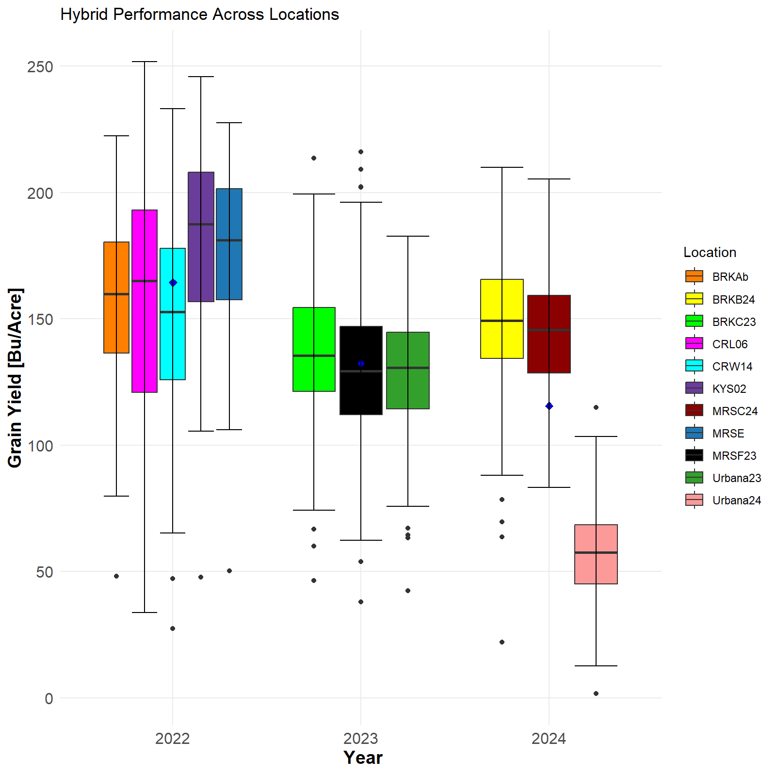
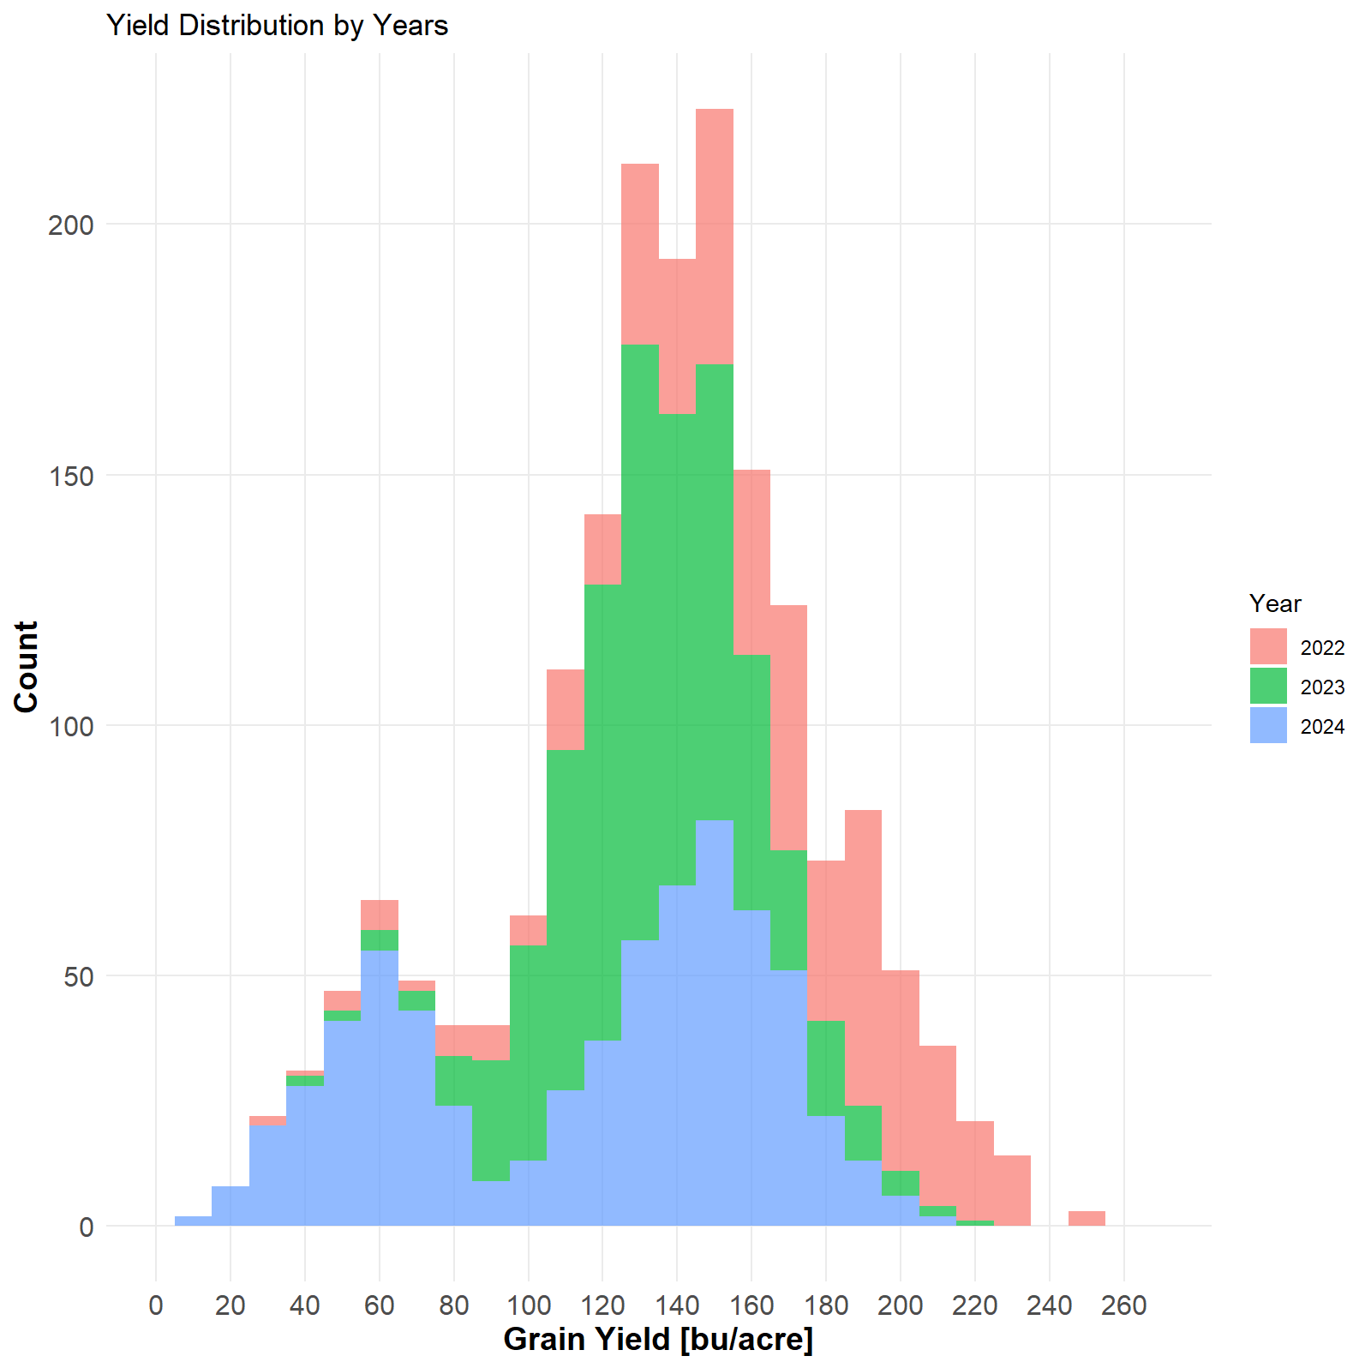
Yield Summary

Slide 5
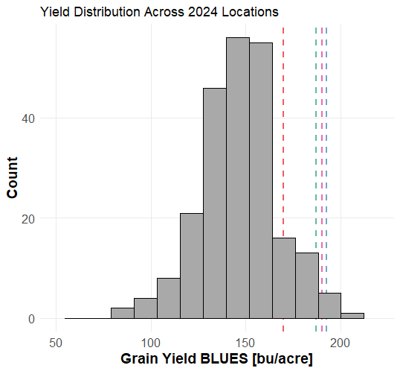
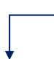
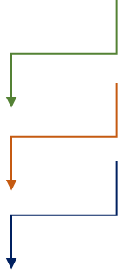
UIUC524
UIUC502
ISU174
183.3
CHECKS

Slide 6
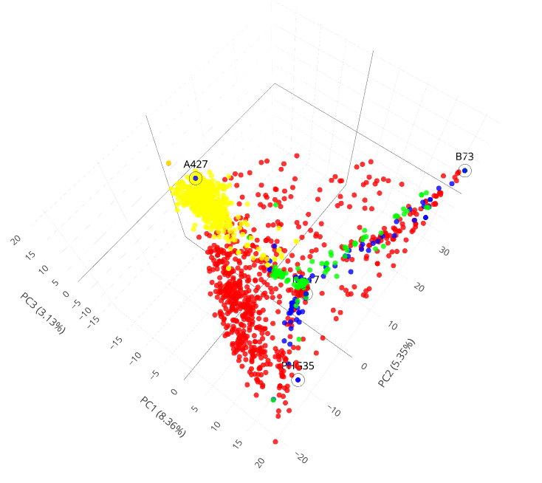
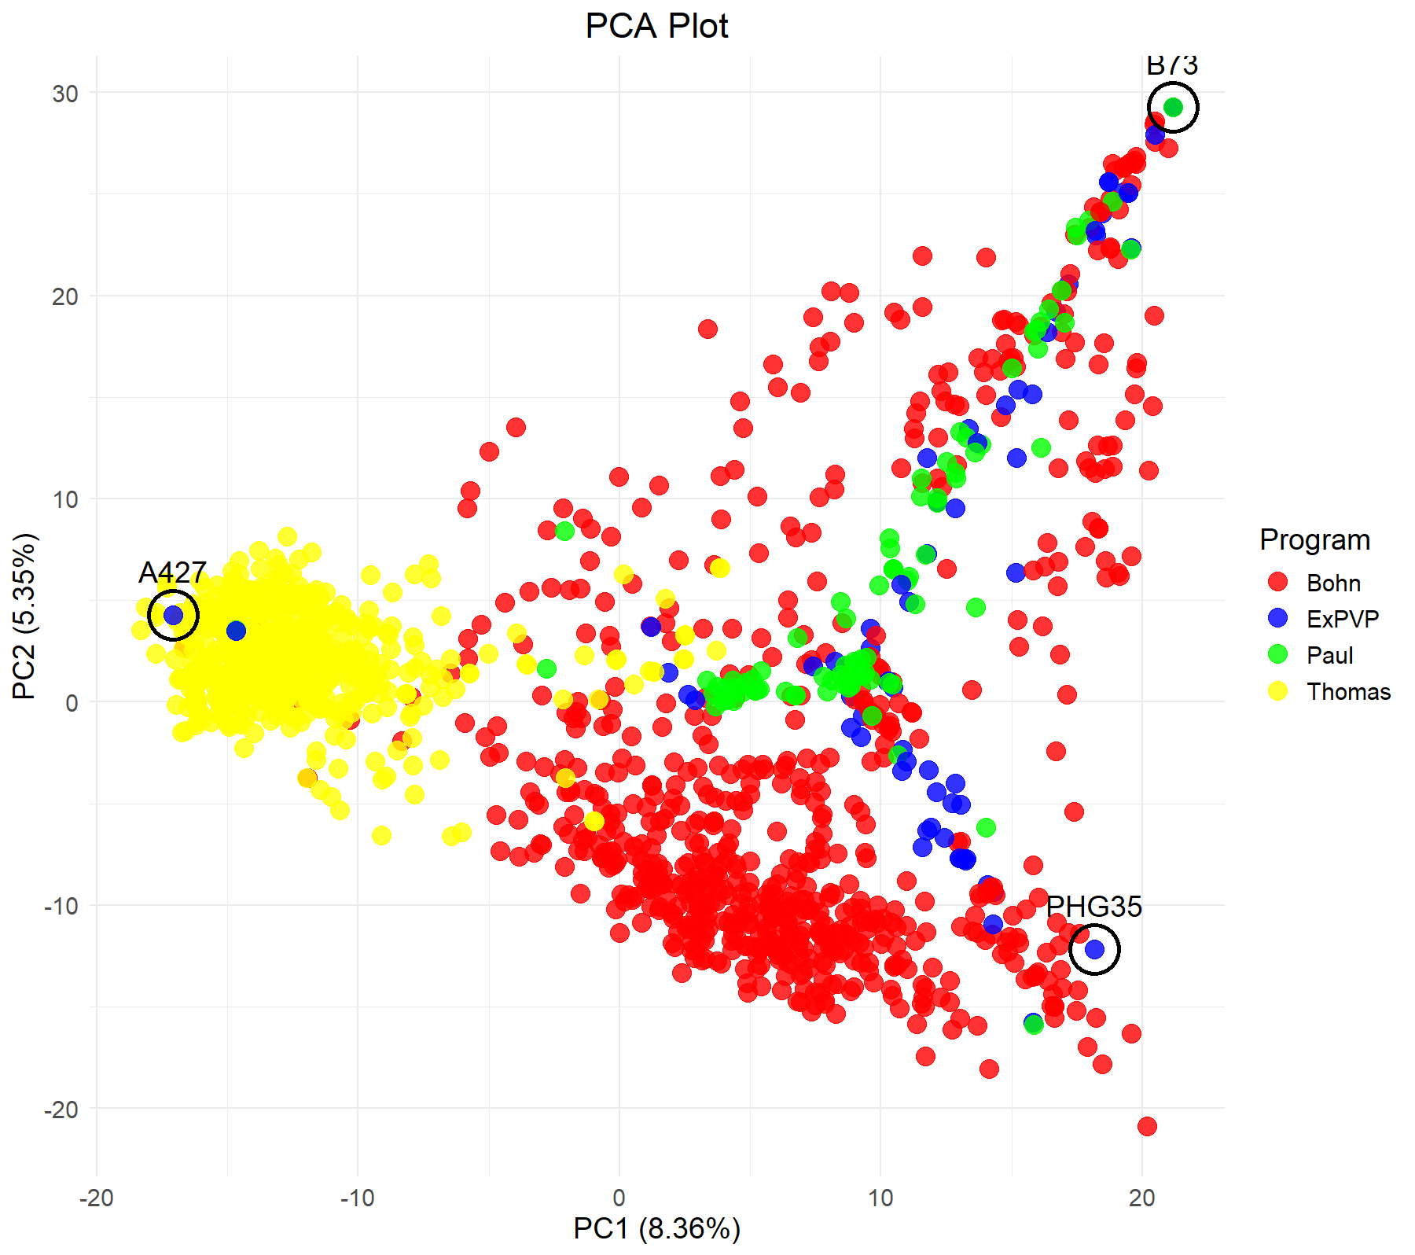
Genetic Structure

Slide 7
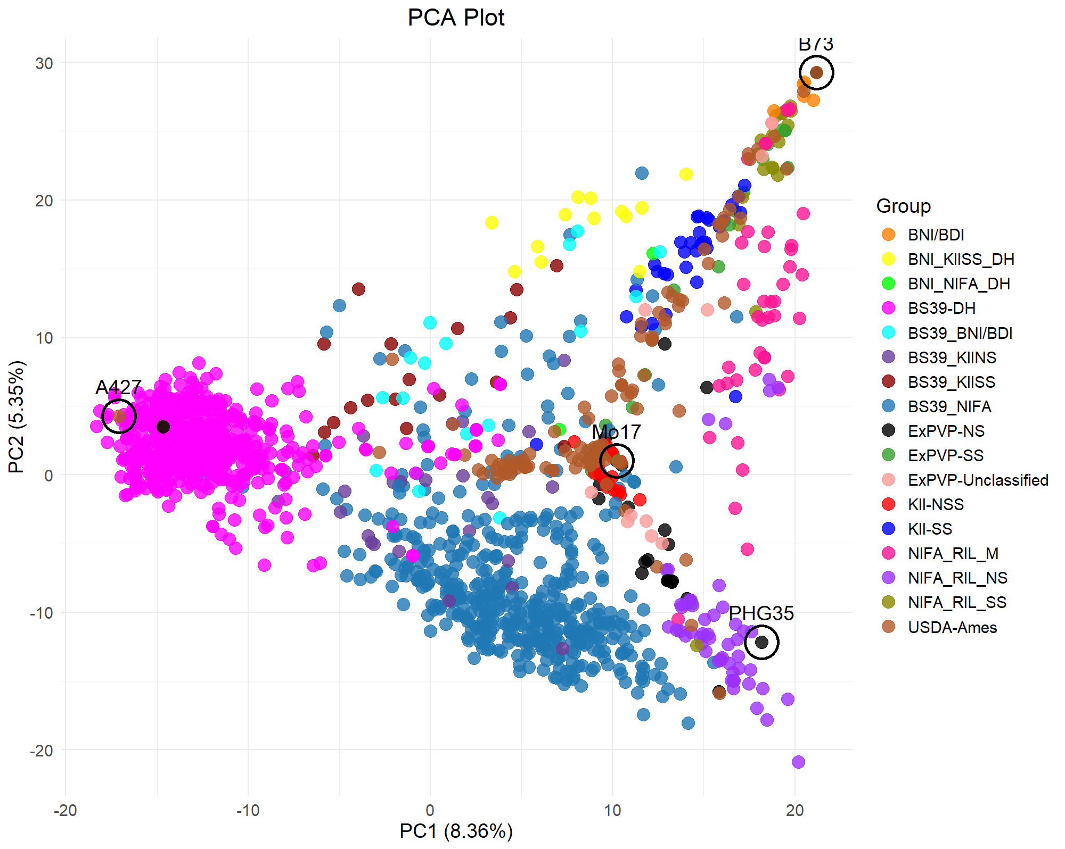
Relatedness Across Programs

Slide 8
Publication Plans
Analysis of genetic diversity within and across programs
- Population Structure analysis within and across programs
- FST (genetic differentiation) between original and new germplasm and across programs
- Allelic diversity contributed by introgression of exotic material (BS39 and Kitale synthetics)
2. Genomic Prediction
- Particularly use 2023 and 2024 BS39 Testcrosses tested across multiple locations
- Predict GCAs of new DH lines in different programs with BS39 background
- Use new BS39 DH testcrosses as Validation set
- Use model to identify best and worst and test them this summer (~800 test crosses created last year)
3. Phenomic Prediction
- Use spectral data in place of marker data to estimate kinship
- Use this matrix in prediction of performance in different environments
QUE MAS????

Slide 9
